Slide 1
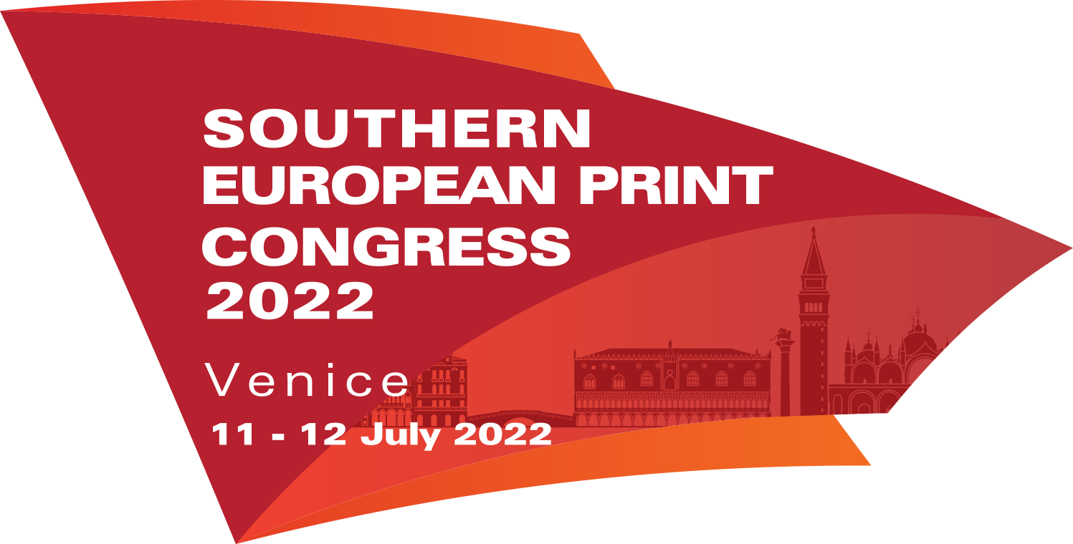
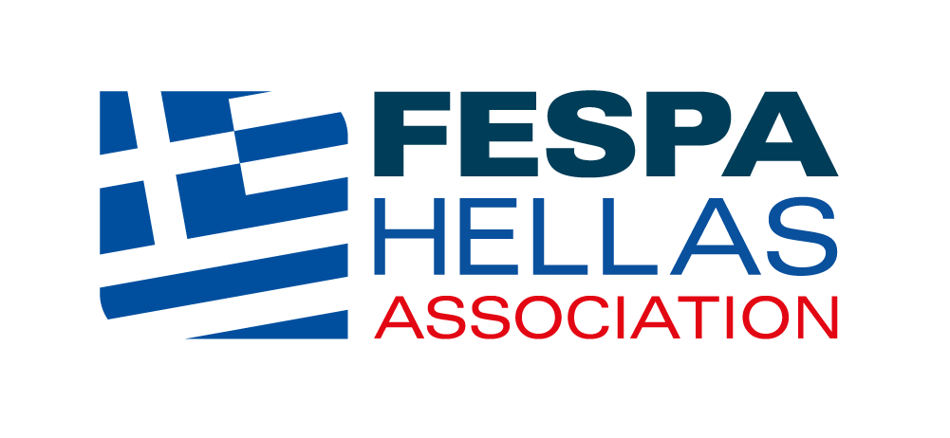
Young talents and sustainable behaviors in the future of Visual Communication and Graphic Industry
The global development prospects of the graphic arts industry and sustainability through integration into educational curricula
– a Hellenic Case study
Dr. Marios Tsigonias
Assist. Prof. in Printing Technology, University of West Attika
Chair of the Board, Hellenic Union of Graphic Arts and Media Technology Engineers, HELGRAMED
Chair of the Board, Graphic Arts Research, Development and Engineering Institute, Member of FESPA Hellas
Member of the Research Group of the Hellenic Graphic-Media Research Lab GRAPHMEDLAB – UniWA
Scientific Collaborator of the Museum of Typography and Graphic Arts Technology – University of Ioannina
Notes:
Good afternoon ladies and Gentlemen, I am really glad to be here with you to talk about Graphic Arts, sustainability and educational curricula and policies.
My mentioned roles in this introductory slide do not try to explain the high unemployment rates in my country but to highlight the possibilities for collaborations that can arise between professional bodies, people, universities, research and social bodies.
In the first part of my presentation I will try to give you a sense of the size of the Market we are all working for and some additional qualitative characteristics.

Slide 2
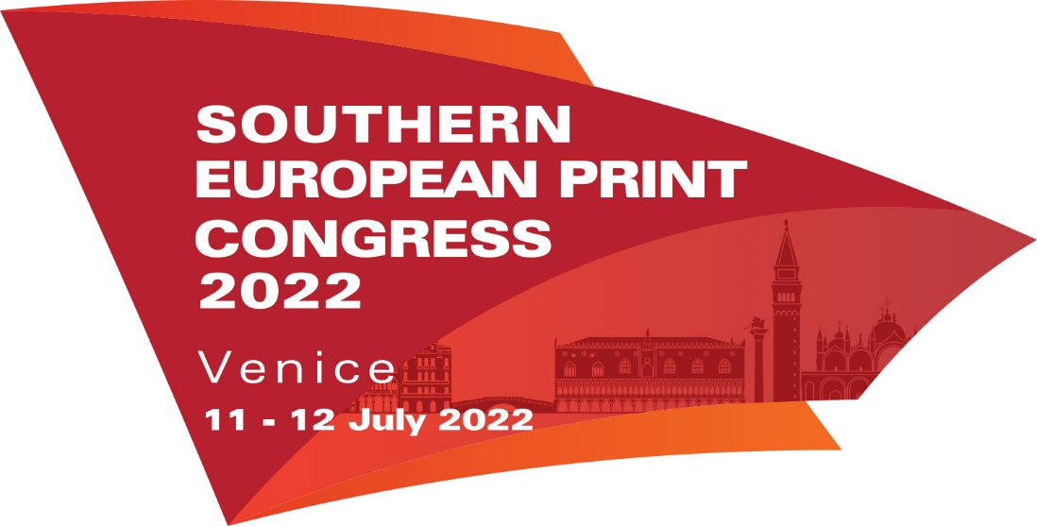
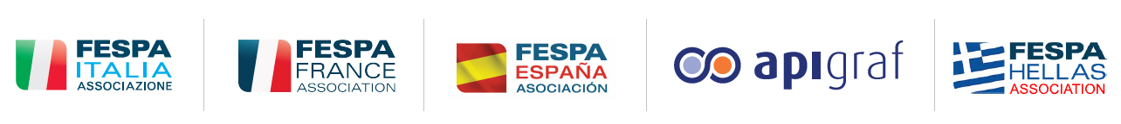

Graphic Arts - The Economical Environment
COVID 19
Notes:
The book market shows unexpected signs of recovery started in the period of pandemic. Forecasts indicate that this market will triple its turnover by the end of the decay!

Slide 3
Graphic Arts - The Economical Environment

Slide 4
Graphic Arts - The Economical Environment

Slide 5
Graphic Arts - The Economical Environment

Slide 6
Graphic Arts - The Economical Environment

Slide 7
Graphic Arts - The Economical Environment

Slide 8
Conclusions
Graphic Arts - The Economical Environment
Printing Market is huge
Printing Market is growthing
Book Market is recovering
Printed Packaging Market is in a great growth

Slide 9
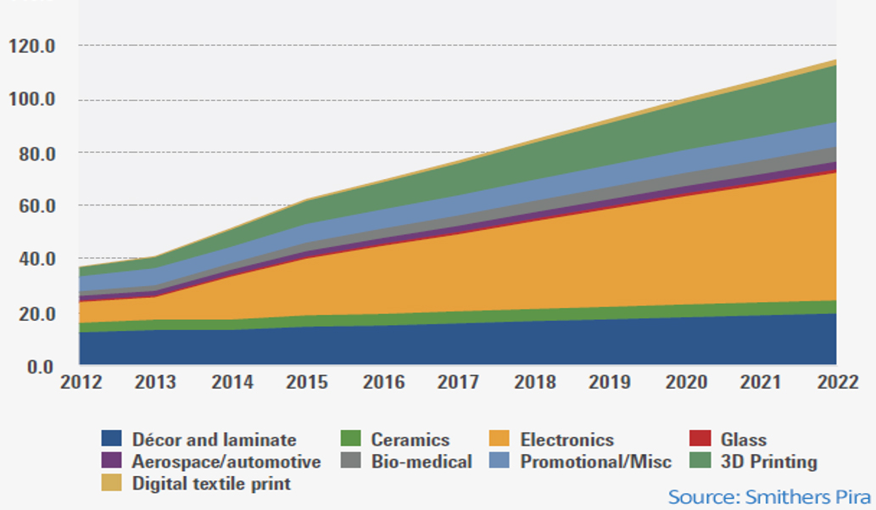
Graphic Arts - The Economical Environment
Growth of the functional and industrial printing market (billion $)
Notes:
In this chart you may see the evolution of the industrial and functional printing sector. You'll notice that some printing applications are growing at a slower rate than others. The mixture is changing.

Slide 10
Graphic Arts – Industrial & Functional Printing applications
Increase of their capacity
Traditional Industrial applications:
Decor & Laminate
Ceramics
Glass
Promotional
Slow development & Stability
Arising Industrial and Functional applications:
Electronics
Aerospace/automotive
Bio-Medical
3D Printing
Digital Textile Printing
Fast development & Evolution
2028 Estimation: Industrial & Functional printing market will be around 250 billion $
Notes:
As presented, industrial and functional printing increases their capacity and differentiates in traditional industrial applications such as printing on glass, ceramics, Décor & Laminate and Promotional printings that are characterized by slow development and stability and in the arising Industrial and Functional applications such as Electronics, Aerospace & automotive, Biomedical, 3D printing and Digital textile printing that are characterized by fast development and evolution. At the end of the decay Industrial and Functional printing Market is estimated to be around 250 billion $ almost 25% of the total printing Market.

Slide 11
Graphic Arts – A Sector in Transition
Printing Market is in transition
Digital transition
Technological transition
Media transition
Ethics transition
Sustainable transition
Notes:
So we may say that the Printing Market is in Transition. Digital, Technological, Media, Ethics and finally Sustainable transition.

Slide 12
Graphic Arts – A Sector in Transition
Printing Market is in transition
New Skills are needed!
Notes:
Since Printing Market is in Transition new skills are needed!

Slide 13
Graphic Arts – New Skills for the Transition
Source: M. Tsigonias (2013)
Notes:
According to John Holland each professional environment may have 6 possible different characteristics. The characteristics of the Graphic Arts Professional Environment were defined from an independent stakeholder group of experts. The professional environment of the Graphic Arts (Greece, 2013) was characterized as Realistic, Investigative and Enterprising.

Slide 14
Graphic Arts – New Skills for the Transition
Skills needed in the Graphic Arts Sector
1. Technical, Hard Skills 40%
2. ICT 20%
3. Management 10,9%
4. Personal (soft) skills 7,3%
5. Creativity 5,5%
5. Sales and marketing 5,5%
Source: Future Skills in the Graphical Industry (INTERGRAPH et al., 2014)
In the Printing Sector transition ICT skills - networking, cloud sourcing, bigdata are increasing - depressing all other skills needed
Notes:
The needed skills for a professional or a new comer in the Graphic Arts sector where defined in the study of INTERGRAPH and collaborative organizations (2014) and they are in confirmation with the results of the previously presented research.

Slide 15
Graphic Arts – New Skills for the Transition
Printing Market is growing - New working places occur
Printing Market is in transition - New Skills are necessary
BUT
You can’t teach an old dog new tricks
Notes:
Since printing market is growing new working places will occur and since printing market is in transition new skills will be necessary. Since you cannot teach an old dog new tricks you shall change your educational basis.

Slide 16
Upgrading the Content of Studies
«Upgrading the content of studies in Secondary Vocational Education and the Post-Secondary Year – Apprenticeship Class» MIS 5027220 - The Hellenic Institute of Pedagogical Policy
Working Team for the Vocational Education for the Applied Arts Sector
Coordinators: Zoe Georgiadou, Anastasios Politis, Marios Tsigonias, UniWA
Experts: Thaleia Dalouka, Charikleia Konsta, Secondary Vocational Education

Slide 17
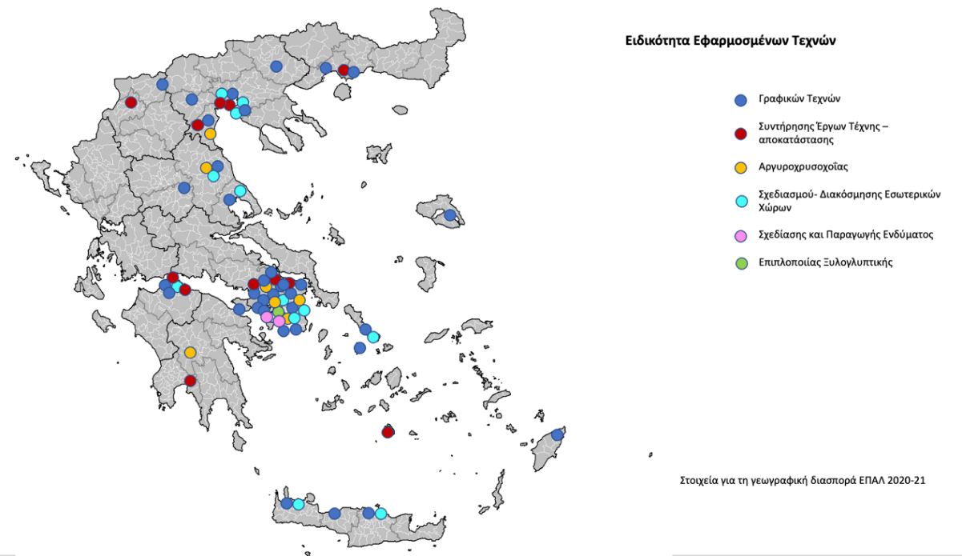
Upgrading the Content of Studies
Current situation
Field: Applied Arts
Specialties (2021):
Interior Design (12)
Silversmithing (7)
Graphic Arts (41)
Conservation of Works of Art – Restoration (10)
Clothing Design and Production (2)
Furniture – Woodcarving (1)
Notes:
As you may see there are much many vocational schools in Greece/Hellas that offer Graphic Arts Studies than any other specialty of the Sector.

Slide 18
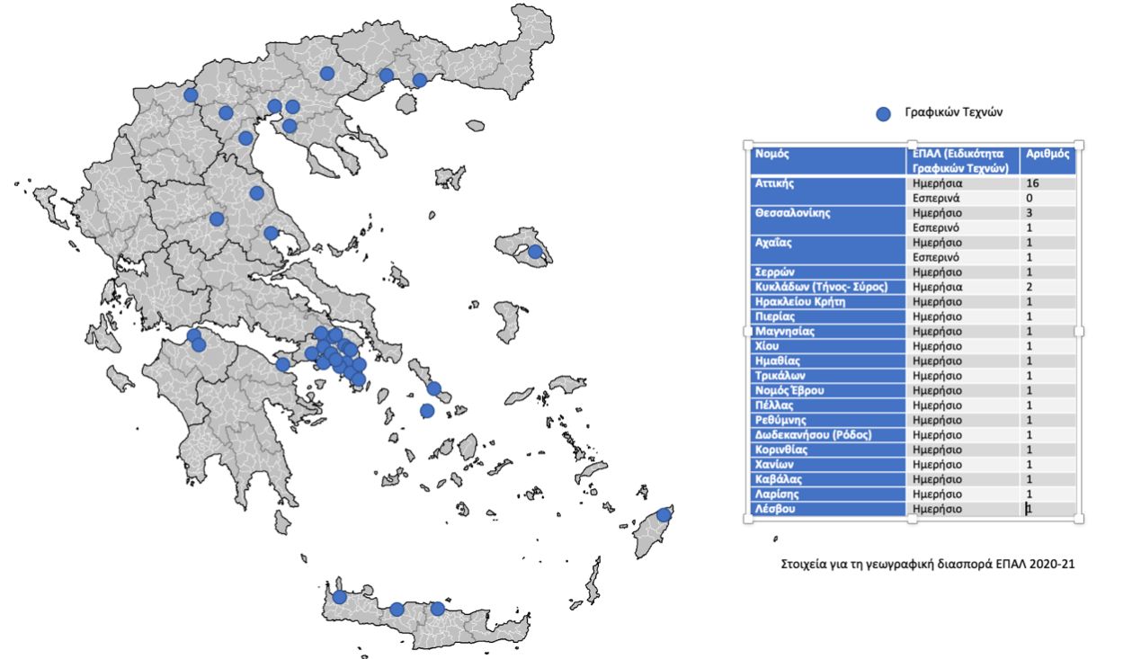
Upgrading the Content of Studies
Current situation
Specialty (2021): Graphic Arts (41)
Most of the schools are settled in Athens far away of the Industrial zones.
This fact combined with the incorrectly cultivated mentality of young people to want to work right next to their home gives them the illusion that there are no new jobs in the industry.
Notes:
You may observe that most of the schools are settled in Athens far away of the Industrial zones. This fact combined with the incorrectly cultivated mentality of young people to want to work right next to their home gives them the illusion that there are no new jobs in the industry

Slide 19
Upgrading the Content of Studies
Current situation
Specialty (2021): Graphic Arts (41)
The synthetic arts in the framings “applied arts” and “graphic arts” creates the misunderstanding that the graphic arts have more to do with Art than with technique, technology, engineering, sciences and industrial applications

Slide 20
Upgrading the Content of Studies
Current situation
Specialty (2021): Graphic Arts (41)
In all these 41 schools students attend curricula dedicated to Art and Graphic Design that give almost no education to professionalism or production processes that require laboratory infrastructure, specialized production systems and software not provided by the Hellenic Public Educational System
Notes:
You may observe that most of them are settled in Athens far away of the industrial zones.

Slide 21
Upgrading the Content of Studies
The proposal of the Working Team:
1st Basic Pylon: RENAME the Field
Applied Arts Field > Creative and Cultural Industries Field
Intended Benefits:
To cultivate the professionalism
To correct the wrong ideas about the characteristics of the professions
To support financially the graduates through European programs for CCI
Notes:
Our Basic Idea to solve the problem was to rename the field. Our proposal is to name it Creative and Cultural Industries Field. Our intention was to cultivate the professionalism in all the specialties of the Field, to correct the wrong ideas about the characteristics of the relevant fields and to give to the graduates the opportunity to participate in European development programs related to Creative and Cultural Industries which can financially support new businesses and new entrants in the concerned professions.

Slide 22
Upgrading the Content of Studies
The proposal of the Working Team:
2nd Basic Pylon: Intergrade Sustainability to the curricula
Sustainability >+< Sustainable Development
Sustainability >+< Knowledge and Skills linked to robotics, software and hardware consolidation and continuous learning due to the high speed of the technological evolution.
Indented Benefits
1. to equip students and consequently future professionals with sustainable development practices, which will allow them to face social and ecological challenges.
Notes:
The second basic Pylon of sustainability integration to the curricula is linked to sustainable development, and has been a cutting-edge issue in improving the quality of everyday life and the well-being of citizens. The development of skills related to sustainable design is an important parameter for achieving such practices and at this level, education plays a crucial role. Especially at the level of vocational education, sustainability is a field that is linked to knowledge and skills that are constantly evolving, linked to robotics, the consolidation of hardware and software and continuous learning, with constant updating of knowledge, due to the speed with which technology evolves. One of the objective of this Pylon is to equip students and consequently future professionals with sustainable development practices, which will allow them to face social and ecological challenges.

Slide 23
Upgrading the Content of Studies
The proposal of the Working Team:
2nd Basic Pylon: Intergrade Sustainability to the curricula
Sustainability >+< Sustainable Development
Sustainability >+< Knowledge and Skills linked to robotics, software and hardware consolidation and continuous learning due to the high speed of the technological evolution.
Indented Benefits
2. Harmonization of teaching practices with the requirements of sustainability is also linked to the training of teachers to create model learning systems.
Notes:
Harmonization of teaching practices with the requirements of sustainability is also linked to the training of teachers to create model learning systems

Slide 24
Upgrading the Content of Studies
The proposal of the Working Team:
3rd Basic Pylon: Digital technologies and resources of digital educational material (DigitalMeans)
Creative industries >+< new technologies, knowledge and online services > high level digital skills are acquired.
Notes:
Creative industries are directly linked to the emergence of new technologies and rely on knowledge, new technologies and online services. This implies the need to acquire a high level of digital skills.

Slide 25
Upgrading the Content of Studies
The proposal of the Working Team:
Decrease the number of the schools providing the Graphic Arts specialty
Rearrange them geographically according to the needs of the topical societies and industry
Creation of strong laboratory settlements for practicing in order to gain the hard skills and ICT skills needed
Notes:
To decrease the number of the schools providing the Graphic Arts specialty and to rearrange them geographically according to the needs of the topical societies and industry
To create strong laboratory settlements for practicing in order to gain the hard skills and ICT skills needed

Slide 26
Upgrading the Content of Studies
The proposal of the Working Team:
A necessary condition:
Operation of one/two full post-secondary year(s) of study so that the technical and vocational education will be at least 2(3) full years.
Notes:
A necessary condition for the substantial development of the sector and specialties in a modern educational design is the operation of a full post-secondary year of study so that the technical and vocational education is 2 years.

Slide 27
Upgrading the Content of Studies
The proposal of the Working Team:
has been accepted by the Hellenic Ministry of Education and we are now in stage B to develop the curricula for Grade C (level 4 EQF) and the post-secondary year/s (level 5 EQF) including all the necessary lessons and learning material
The last stage is the Pilot application of the curricula hopping that the evaluation will give us positive results.
Notes:
The proposal has been accepted by the Hellenic Ministry of Education with minor differentiations and we are now in stage B to develop the curricula for Grade C (level 4 EQF) and the post secondary year (level 5 EQF) including all the necessary lessons and learning material
The last stage is the Pilot application of the curriculum hopping that the evaluation will give us positive results.
A necessary condition for the substantial development of the sector and specialties in a modern educational design is the operation of a full post-secondary year of study so that the technical and vocational education is 2 years.
We hope that in the next 12 months we will have some more good news about this project to present you.

Slide 28
Young talents and sustainable behaviors in the future of Visual Communication and Graphic Industry
Thank you for your attention. Any Questions?
The global development prospects of the graphic arts industry and sustainability through integration into educational curricula
Marios Tsigonias
tsigonias@yahoo.gr & mtsigonias@uniwa.gr

Slide 29
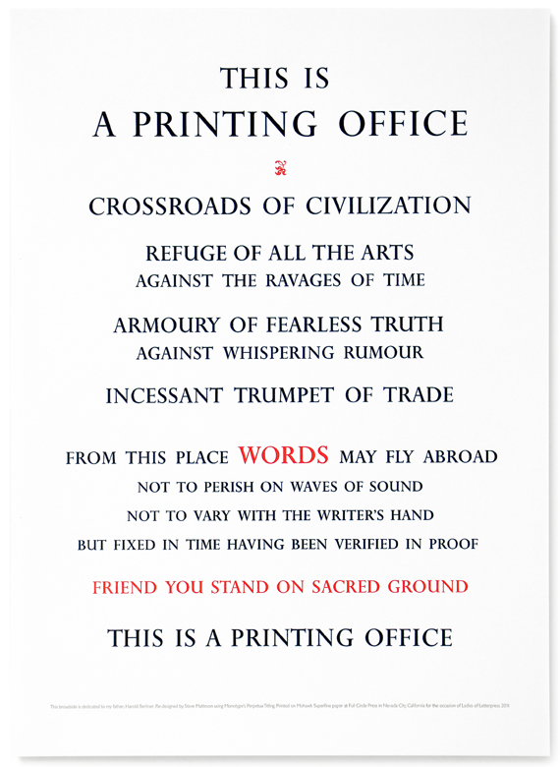

Graphic Arts – Ethical Transition
Notes:
This is a printing office. Crossroads of civilization, refuge of all the arts, against the ravages of time. Armoury of fearless truth against whispering rumour. Incessant trumpet of trade. From this place words may fly abroad, not to perish on waves of sound, not to vary with the writer’s hand but fixed in time having been verified in proof. Friend you stand on sacred ground. This is a printing office. Beatrice Warde

